Slide 1
Summer Term 23 Safe Reinforcement Learning for Self-Adaptive Systems Lecture-5: Deep Q-Network
Prof. Dr. Holger Giese (holger.giese@hpi.uni-potsdam.de)
Christian Medeiros Adriano (christian.adriano@hpi.de) - “Chris”
He Xu (he.xu@hpi.de)
Sona.Ghahremani (sona.ghahremani@hpi.de)

Slide 2
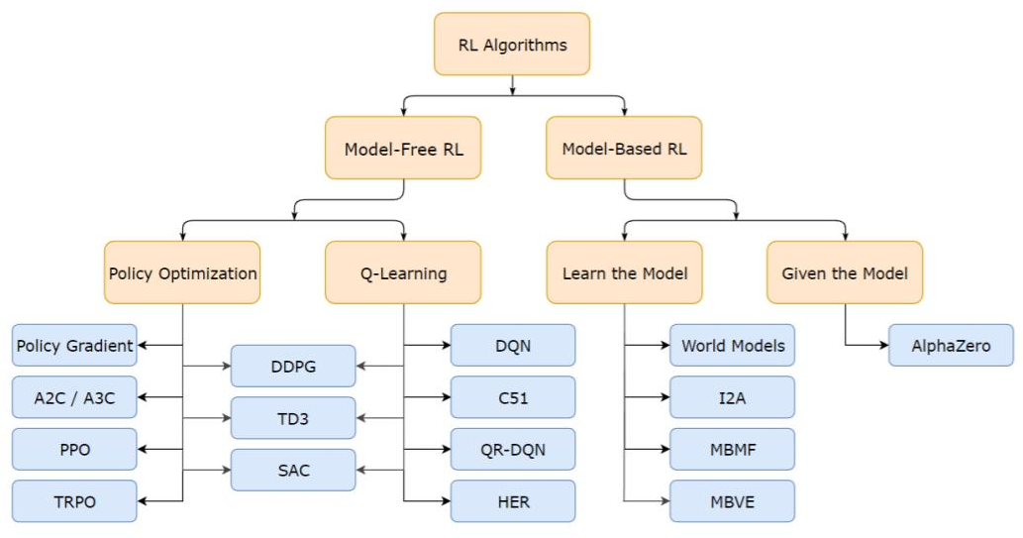
Brief Taxonomy of RL Methods

Slide 3
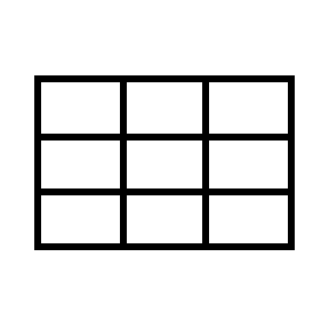
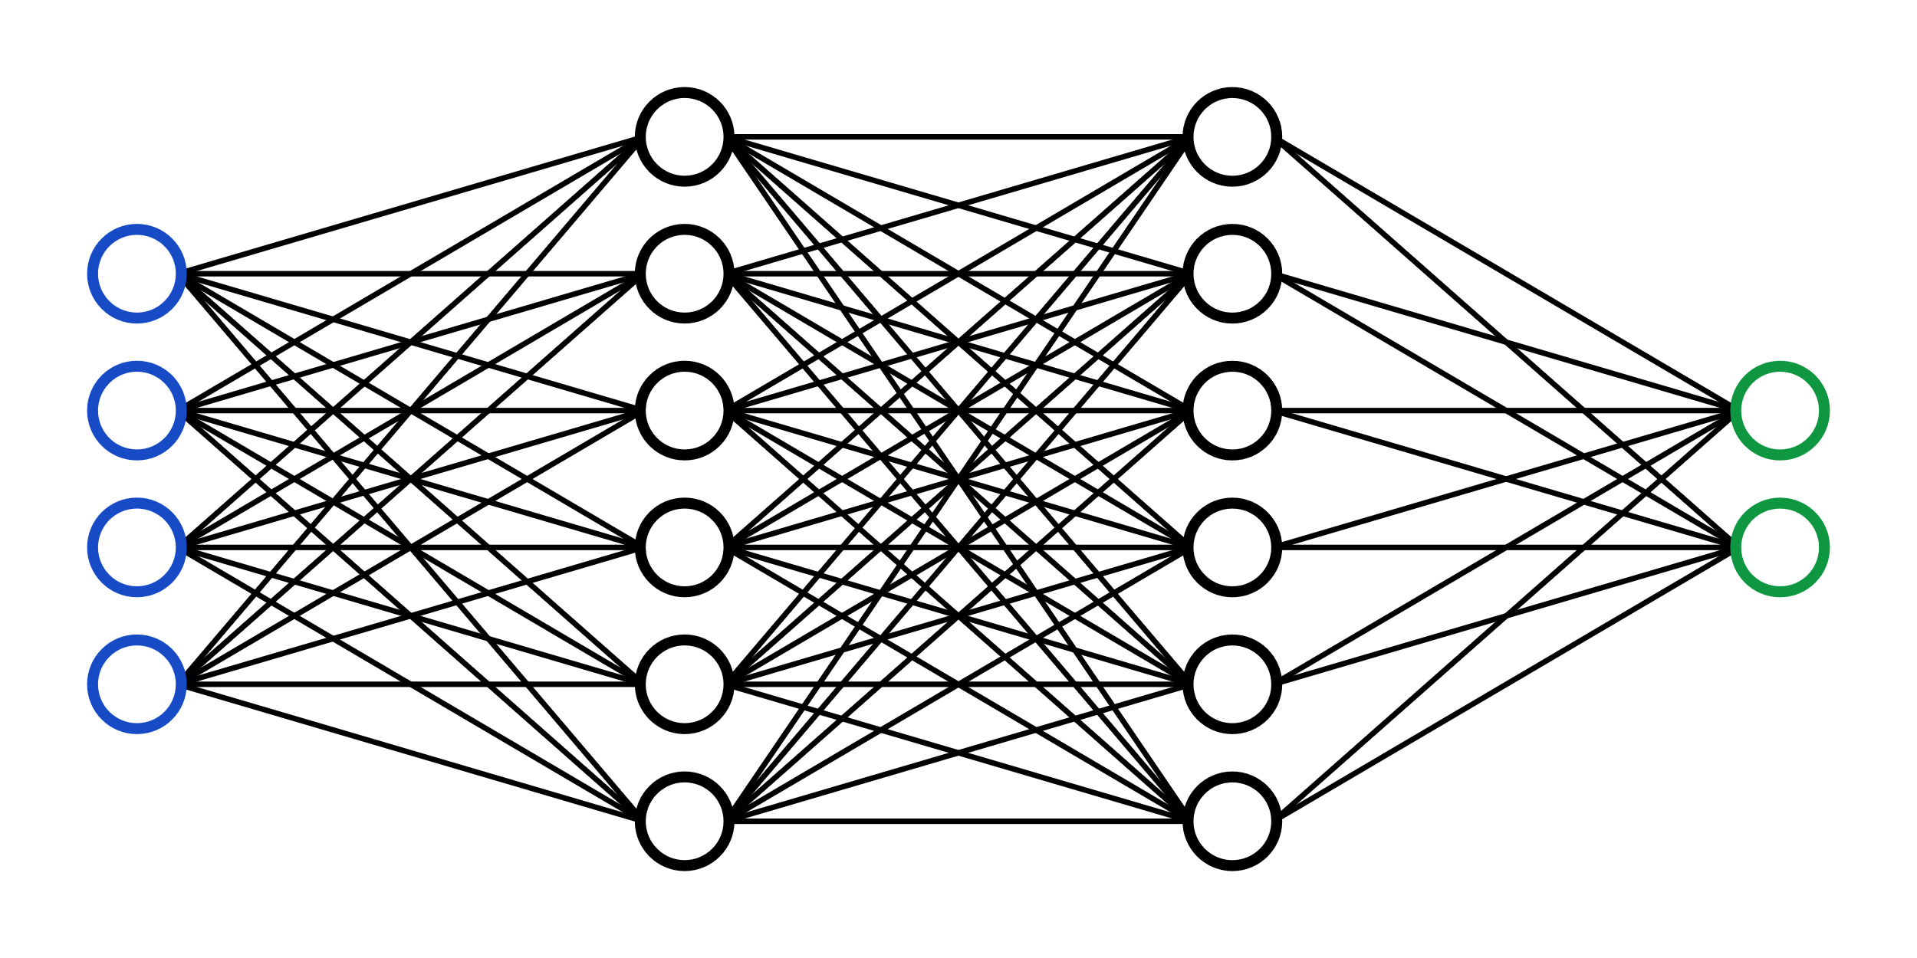
DQN - Deep Q-Network [Mnih 2013]
Q-Table
State
Action
Grows too large for continuous state-spaces
Q-value
Q-function
State
Action
F
Q-value
Like Double-Q-Learning, DQN is initialized with arbitrary Q-values and explores the environment using the ε-greedy policy.
It updates its Q-value via dual actions:
a current action with a current Q-value
a target action with a target Q-value
Q-network
State
Action
Q-value
Mnih, V., Kavukcuoglu, K., Silver, D., Graves, A., Antonoglou, I., Wierstra, D., & Riedmiller, M. (2013). Playing atari with deep reinforcement learning. arXiv preprint arXiv:1312.5602.

Slide 4
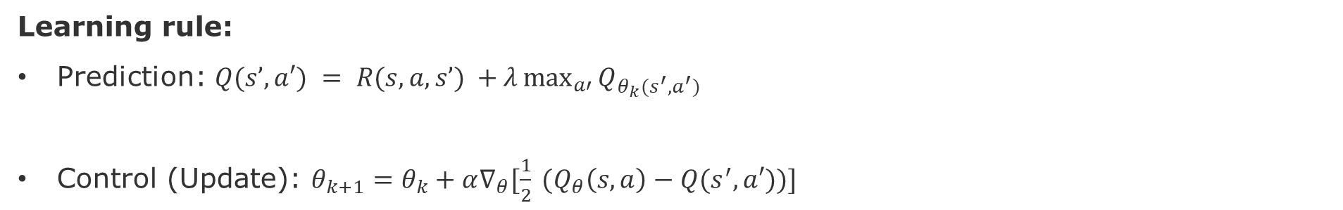
Approximate Q-Learning
Instead of a table, one can have a parameterized Q function: $Q_{θ}$
Or a neural net, decision tree, etc.
Learning rule:
Prediction: $Q(s’,a′) = R(s,a,s’) +λ\max_{a′}{Q_{θ_{k}(s^{′},a^{′})}}$
Control (Update): $θ_{k+1}=θ_{k}+α∇_{θ}[\frac{1}{2} (Q_{θ}\left(s,a\right)−Q(s^{′},a′))]$
source: Pieter Abeel - L2 Deep Q-Learning (Foundations of Deep RL Series), 2022

Slide 5
DQN - Components [Mnih 2013]
Experience Replay
Replay Buffer
Environment
Actual network
Target network
There is no restriction on the neural network architecture itself. Therefore, one could use:
RNN for Text
CNN for Images
LSTM for regular data
GNN for graph data?
Which ever choice of network architecture, both actual and target networks should have the same architecture
Mnih, V., Kavukcuoglu, K., Silver, D., Graves, A., Antonoglou, I., Wierstra, D., & Riedmiller, M. (2013). Playing atari with deep reinforcement learning. arXiv preprint arXiv:1312.5602.

Slide 6
DQN – Why experience replay?
trained it with single samples, each sample and the corresponding gradients would have too much variance, and the network weights would never converge.
Why few actions in sequence one after the other and then feed that data as a batch to the Q Network? That should help to smoothen out the noise and result in more stable training, shouldn’t it?
Deep Learning best practice requires selecting a batch of samples after shuffling to ensure enough diversity in the training so the network can generalize
Sequential actions are strongly correlated. Replay buffer allows to make the data i.i.d. which is necessary for training a neural net.
Why i.i.d. matters?
Identically Distributed allows to build a prediction model of Y given a set of features, e.g., P(Yi|Xi)
Independent guarantees the rows in the data present new information to train the model and sufficient (but not necessary condition) for:
For consistency and providing error bounds
For random sampling techniques
Notes:
https://stats.stackexchange.com/questions/213464/on-the-importance-of-the-i-i-d-assumption-in-statistical-learning
Pieter Abeel short lecture on DQN.
https://youtu.be/Psrhxy88zww?t=1123
Deep RL – DQN – Matteo Hessel
https://youtu.be/cVzvNZOBaJ4?list=PLqYmG7hTraZCRwoyGxvQkqVrZgDQi4m-5&t=827
Actor-Critic Lecture from Hado van Hasselt
https://youtu.be/y3oqOjHilio?list=PLqYmG7hTraZCRwoyGxvQkqVrZgDQi4m-5&t=4653

Slide 7
DQN – Why do we need a Target Network?
Because it is more stable
Note that the target network doesn’t get trained, therefore, its weights remain stable for at least a short period.
After a parameterized number of time-steps, the learned weights from the Q Network are copied over to the Target Network.

Slide 8
DQN – Training Process
Predict Q-Values on
Q-Network
Experience replay collects training samples by interacting with the environment
Sample a random batch of data from the replay buffer
Predict Q-Values on
Target-Network
Every T steps, overwrite the Target-Network weight with the current Q-Network weights
Train Q-Network
Keep Target-Network fixed
Compute loss

Slide 9
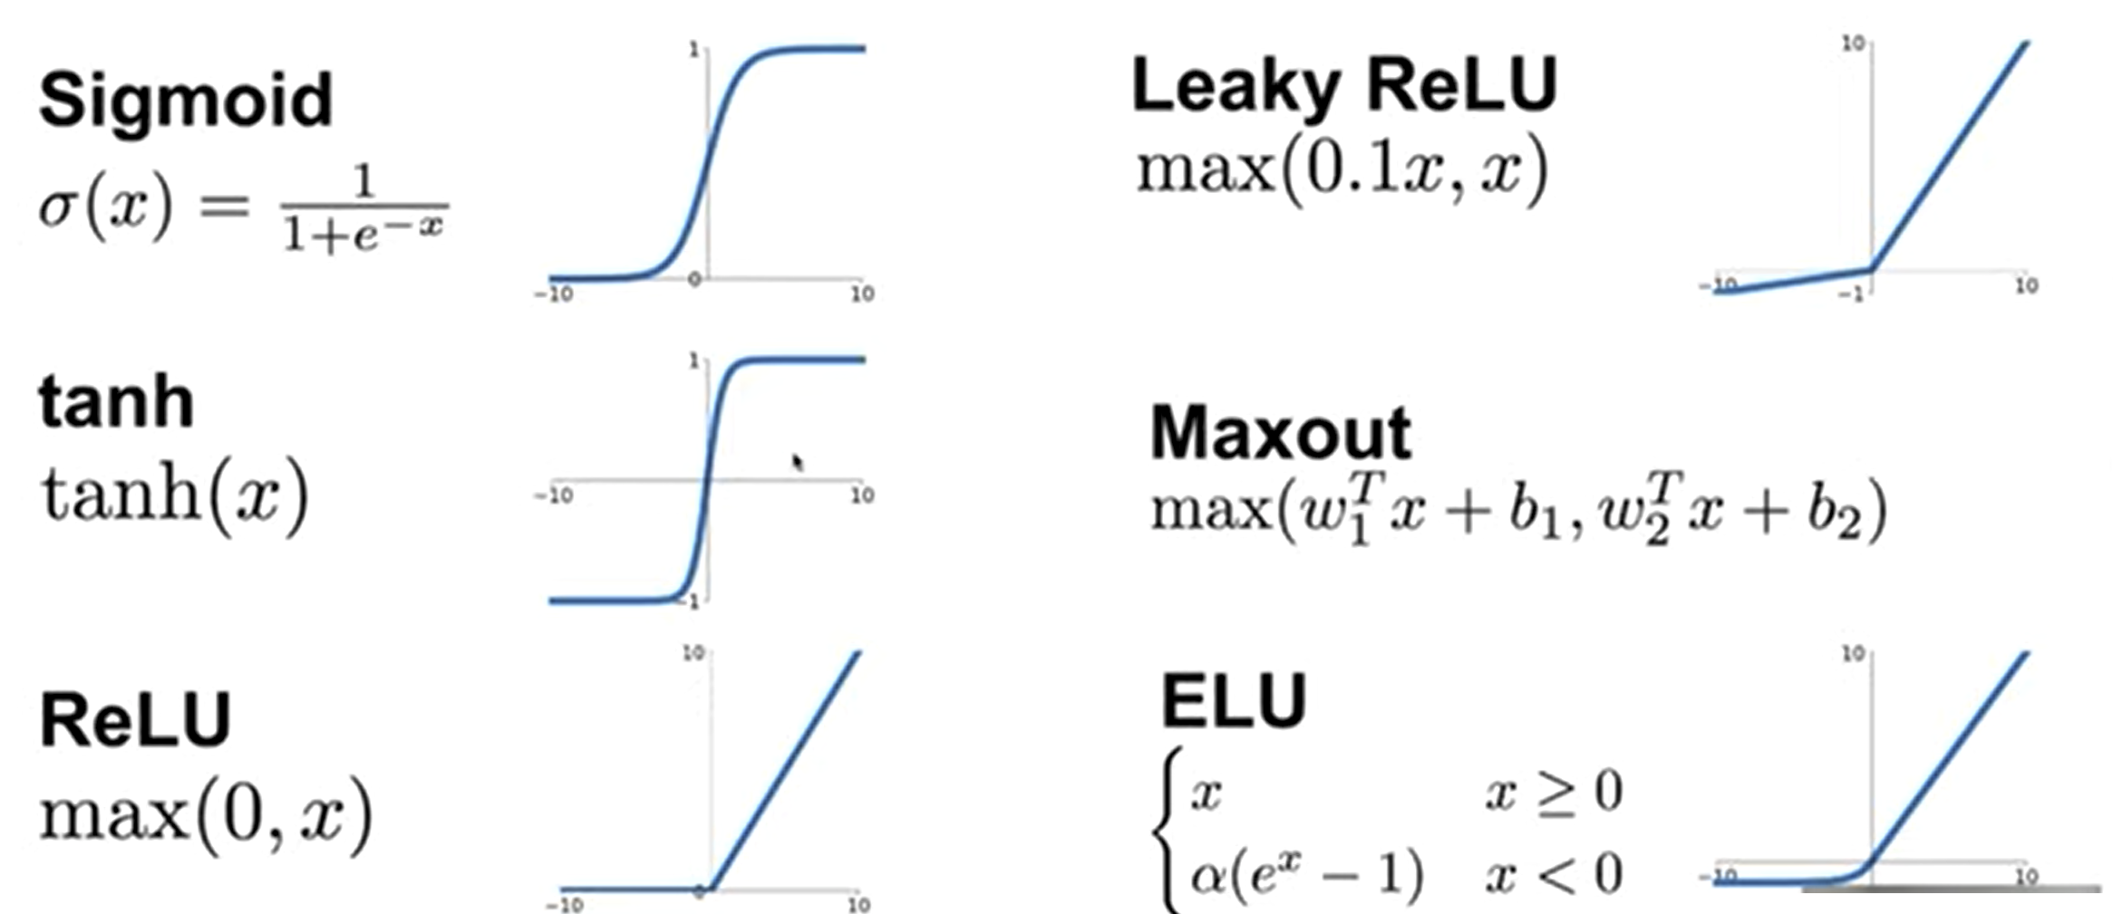
Activation Functions

Slide 10
Optimization methods
Non-Convex Problem:
Gradient-based methods are surprisingly effective (convergence and speed)
Minibatch stochastic gradients instead of full gradients
Gradient calculation done by Automatic Differentiation
Most common uses:
Stochastic Gradient Descent + Momentum + Preconditioning
e.g., RMSProp, Adam, Adamax

Slide 11
More advanced models
Actor-Critic Model
Batch Reinforcement Learning
Hierarchical Reinforcement Learning
Bayesian Reinforcement Learning
Hidden Markov Models
Partially Observable Markov Decision Processes
….

Slide 12
Interesting lectures
David Silver, 2015, University College London Lecture 1 https://www.youtube.com/watch?v=2pWv7GOvuf0 Lecture 2 https://www.youtube.com/watch?v=lfHX2hHRMVQ&list=PLqYmG7hTraZDM-OYHWgPebj2MfCFzFObQ&index=2&pbjreload=10 Lecture 3 https://www.youtube.com/watch?v=Nd1-UUMVfz4&list=PLqYmG7hTraZDM-OYHWgPebj2MfCFzFObQ&index=3&pbjreload=10 Course website: https://www.davidsilver.uk/teaching/ | Bottom-up explanations based on introducing the simpler models before adding the complexity that justify more complex models. Explains the math behind concepts.
Pascal Poupert, 2018, University of Waterloo, Canada Lecture 1b: https://www.youtube.com/watch?v=yOWBb0mqENw&list=PLdAoL1zKcqTXFJniO3Tqqn6xMBBL07EDc&index=2&pbjreload=10 Lecture 2a: https://www.youtube.com/watch?v=yOWBb0mqENw&list=PLdAoL1zKcqTXFJniO3Tqqn6xMBBL07EDc&index=2&pbjreload=10 Lecture 2b: https://www.youtube.com/watch?v=mjyrRG7RD84&list=PLdAoL1zKcqTXFJniO3Tqqn6xMBBL07EDc&index=5&pbjreload=10 Course website: https://cs.uwaterloo.ca/~ppoupart/teaching/cs885-spring20/schedule.html | More conceptual level with examples of applications.
Charles Isbell & Michael Littman, 2015, Georgia Tech https://www.youtube.com/watch?v=rETmf4NnlPM&list=PL__ycckD1ec_yNMjDl-Lq4-1ZqHcXqgm7&index=128&pbjreload=10 Pieter Abeel – Short lectures https://youtu.be/Psrhxy88zww?t=1123 | Step-by-step explanations with fun discussions and lot of small examples to illustrate each core MDP principle
Nando Freitas, 2015, Lectures Oxford University, UK Lecture 15 https://www.youtube.com/watch?v=kUiR0RLmGCo Lecture 16 https://www.youtube.com/watch?v=dV80NAlEins Course Website: https://www.cs.ox.ac.uk/people/nando.defreitas/machinelearning/ | Lectures in the context of Deep Learning, but still provide the necessary concepts of RL.

Slide 13
Assignment – May 23
Prepare a 20 min presentation of the following algorithms:
Ardalan - Review DQN, Double-DQN, Dueling Double-DQN
Luca - A2C, A3C, SAC
Finn - PPO, DDPG/TD3, TRPO
For each algorithm:
Motivation - what are the problem that the algorithm is trying to solve?
Approach - what are the insights/innovation/tricks that enabled the new algorithm?
Assumption - what are the necessary conditions for the algorithm to perform well?
Activity diagram - high-level steps taken by the algorithm?
Pseudo code - Latex format (https://www.overleaf.com/learn/latex/Algorithms)
Rationale – moving forward we will discuss the pros and cons of each approach w.r.t. safety. Therefore, in order that you can discuss the safety requirements and corresponding solutions, it is fundamental that you have a very good understanding of the algorithms.

